Slide 1

Capstone: Attribution
Learn SQL from Scratch
Marije van Schie
08/08/2018

Slide 2


Hi there,
My name is Marije van Schie. I am from The Netherlands, Europe. I work as a stragetic program manager for a SaaS company called Blue10. Blue10 offers a Cloud solution for the digital processing of booking documents, such as procurement invoices, sales invoices, receipts, etc. The online workflow can be used to have an invoice inspected and approved digitally by one or more employees. Once an invoice has gone through the entire process in Blue 10, the document can easily be accessed in the digital archive and is retrievable from any location.
As a stragetic program manager I am responsible for different strategic programs within the company. Before the course I have played with data quite a bit in data visualization tools (like Power BI) and Excel, but always relied on others to do the SQL. I really liked the course and learned a lot of it.
English isn’t my first language, so please excuse any mistakes.

Slide 3
Table of Contents
Get familiar with CoolTShirts
What is the user journey?
Optimize the campaign budget
* The queries used to find that data are all included in the .sql file

Slide 4
1. Get familiar with CoolTShirts

Slide 5
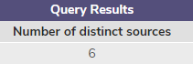
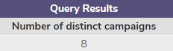
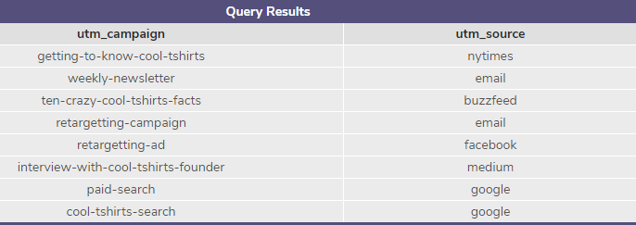
1.1 Traffic CoolTShirts
CoolTShirts sells shirts of all kinds, as long as they are T-shaped and cool. They started 8 marketing campaigns to increase website visits and purchases. CoolTShirts uses 6 sources from where the traffic is send to their website. A campaign is a specific program that is designed to market the product. Each campaign can be launched via a different channel. The specific channel that is used to drive a potential customer to a website is called the ‘source’. Sources can be used for more than one campaign.
Source used for each campaign

Slide 6
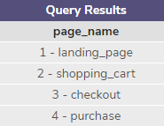

1.2 Website
There are 4 pages on the website of CoolTShirts, shown in the graph. The goal of CoolTShirts must be to increase the conversion rate from landingspage to purchase.
Using touch attribution, they can map their customers' journey: from initial visit to purchase. A customer journey is the route your customer takes to complete your desired conversion action. CoolTShirts can use that information to optimize their marketing campaigns.

Slide 7
2. What is the user journey?

Slide 8
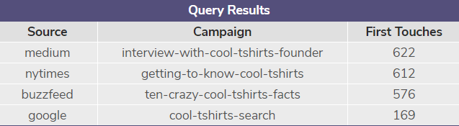
2.1 First touches
The following campaigns are responsible for first touches:
WITH first_touch AS (
SELECT user_id,
MIN(timestamp) as first_touch_at
FROM page_visits
GROUP BY user_id
),
ft_alloc AS (
SELECT first_touch.user_id,
first_touch.first_touch_at,
page_visits.utm_source,
page_visits.utm_campaign
FROM first_touch
JOIN page_visits
ON first_touch.user_id = page_visits.user_id
AND first_touch.first_touch_at = page_visits.timestamp
)
SELECT
ft_alloc.utm_source AS Source,
ft_alloc.utm_campaign AS Campaign,
COUNT(*) AS 'First Touches'
FROM ft_alloc
GROUP BY 2
ORDER BY 3 DESC;
This means that, for example, 622 visitors came for the first time to CoolTShirts.com due to the campaign interview-with-cool-tshirts-founder

Slide 9
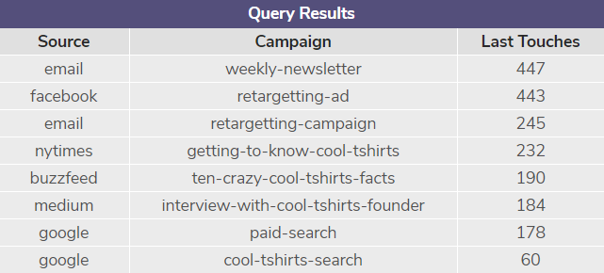
2.1 Last touches
The following campaigns are responsible for last touches:
WITH last_touch AS (
SELECT user_id,
MAX(timestamp) as last_touch_at
FROM page_visits
GROUP BY user_id
),
lt_alloc AS (
SELECT last_touch.user_id,
last_touch.last_touch_at,
page_visits.utm_source,
page_visits.utm_campaign
FROM last_touch
JOIN page_visits
ON last_touch.user_id = page_visits.user_id
AND last_touch.last_touch_at = page_visits.timestamp
)
SELECT
lt_alloc.utm_source AS Source,
lt_alloc.utm_campaign AS Campaign,
COUNT(*) AS 'Last Touches'
FROM lt_alloc
GROUP BY 2
ORDER BY 3 DESC;
This means that, for example, 447 visitors has the last time been at CoolTShirts.com due to the campaign weekly-newsletter.

Slide 10
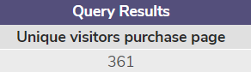
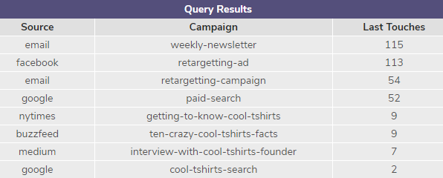
1.3 Purchases
SELECT COUNT (DISTINCT user_id) AS 'Unique visitors purchase page'
FROM page_visits
WHERE page_name = '4 - purchase';
361 unique visitors made a purchase on CoolTShirts.
WITH last_touch AS (
SELECT user_id,
MAX(timestamp) as last_touch_at
FROM page_visits
WHERE page_name = '4 - purchase'
GROUP BY user_id
),
lt_alloc AS (
SELECT last_touch.user_id,
last_touch.last_touch_at,
page_visits.utm_source,
page_visits.utm_campaign
FROM last_touch
JOIN page_visits
ON last_touch.user_id = page_visits.user_id
AND last_touch.last_touch_at = page_visits.timestamp
)
SELECT
lt_alloc.utm_source AS Source,
lt_alloc.utm_campaign AS Campaign,
COUNT(*) AS 'Last Touches'
FROM lt_alloc
GROUP BY 2
ORDER BY 3 DESC;
Each purchase can be attributed to a certain campaign. Below you can see how many purchases each campagn is responsible for. Weekly-newsletter was most succesful.
+
361

Slide 11
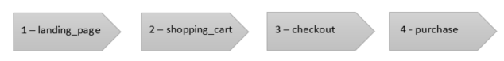
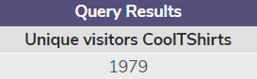
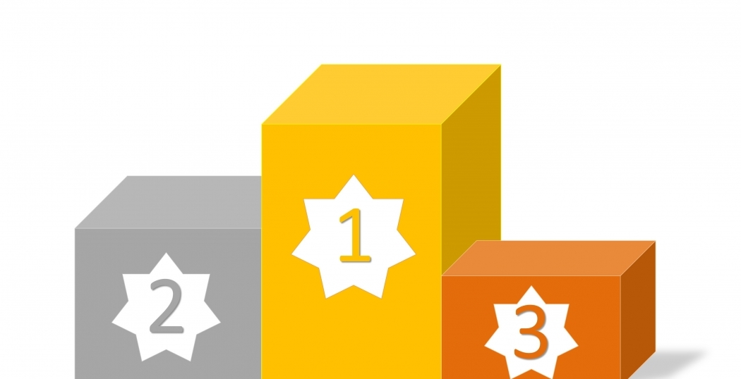
1.4 Typical user journey
Conversion rate
visitor to purchase:
18,25%
Top 3 of:
Campains responsible for the most first touches:
Interview-with-cool-tshirts-founder
Getting-to-know-cool-tshirts
Ten-crazy-cool-tshirts-facts
SELECT COUNT (DISTINCT user_id) AS 'Unique visitors CoolTShirts'
FROM page_visits;
SELECT COUNT (DISTINCT user_id) AS 'Unique visitors purchase page'
FROM page_visits
WHERE page_name = '4 - purchase';
Campains responsible for the most last touches:
Weekly-newsletter
Retargetting-ad
Retargetting-campaign

Slide 12
3. Optimize the campain budget

Slide 13
3.1 Advice re-invest
That being said, both first-touch attribution and last-touch attribution are very important.
If they want to focus on more traffic to their website, the advice will be to re-invest in de following campaigns:
If they want to focus on more purchases, the advice will be to re-invest in de following campaigns
Best advise is probably to do both. ‘No sale ever gets made if customers doesn’t know you exist’. And ‘There will be no revenue if no one made the purchase’
First-touch attribution only considers the first source for each customer. This is a good way of knowing how visitors initially discover a website.
Last-touch attribution only considers the last source for each customer. This is a good way of knowing how visitors are drawn back to a website, especially for making a final purchase.
There are a lot of different ways to assign value to campaigns and touch points. Is the first touch (like clicking a facebook ad) more important than the e-mail that generated the actual purchase? Or, should credit get divided up equally across each touchpoint? There are different ways to look at marketing attribution.

